Slide 1
MEDICAL EDUCATION IN PALESTINE PAST PRESENT AND FUTURE
First International Medical conference
Faculty of Medicine Annajah University

Slide 2
1900-1950
Modern medicine has been introduced to Palestine at the beginning of the 20 tieth century at the end of Ottoman period.
During the British mandate no significant hospital structure were added
Health remained an activity related to religious missions and other communitarian organizations

Slide 3
Palestinian Arab Medical Association
By the end of forties of the last century a Palestinian medical association was founded and a medical journal was published.

Slide 4

P M J
First Palestinian Medical Journal was under the name of the Palestinian Arab Medical Association Journal (1945 and 1946) .
This journal was world wide.

Slide 5
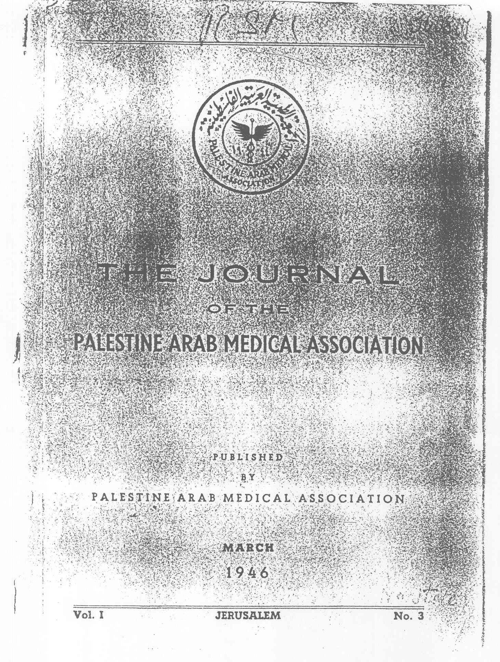
هيئة التحرير
الدكتور توفيق كنعان الدكتور فاهان قلبيان
الدكتور يوسف حجار الدكتور محمود دجاني
الدكتور ابراهيم جورج الدكتور فوقي فريج
Editorial Board
Dr. T. Canaan Dr. Y. Hajjar
Dr. F. Kalbian Dr. M. Dajani
Dr. I. George Dr. Ph. Frajj

Slide 6
Augusta Victoria Hospital
1945-1967
During the war and after the disaster of 48 there was a necessity to develop health structures and professionals. Augusta Victoria Hospital played a major role in the years fifty in developing the training of physicians and nurses.

Slide 7
Augusta Victoria Hospital
1945-1970
The late Dr Amin Majaj can be considered as the founder of the Palestinian school of pediatrics and the initiator of Medical research and training in Palestine, the 67 war had affected heavily his ascending career but his example remained (works on nutrition, Vitamin E, Trace elements etc…)
The organization of the Third Mediterranean conference in Jerusalem 1964

Slide 8
1970-1985
Increasing role of NGOs in Primary health care
Growing numbers of Physicians trained in different countries and health systems
Foundations of Major hospital structures by NGOs
Ascending Role Of Makassed Hospital as referral center

Slide 9
Makassed Hospital 1985-..
Visionary administration Late Mr. M Hebeya
Active minority of specialist against all odds
Foundation of the first Residency Program
Publications in international medical journals
The emergence of the faculty of Medicine

Slide 10
Palestinian faculty of Medicine
Al-Quds university 1994- Dr. Nael shehabi
1999- Annajah campus
2000- Alazhar Gaza campus
2006- Islamic university Gaza
2007 Annajah faculty of Medicine and the Planning for Annajah National university hospital

Slide 11
Palestinian Medical council
1994-2006 struggle to impose rules
2006 Independent professional body by law
2008 National supervising committee for postgraduate training
2008 first national qualifying Exam for admission to special training

